Slide 1
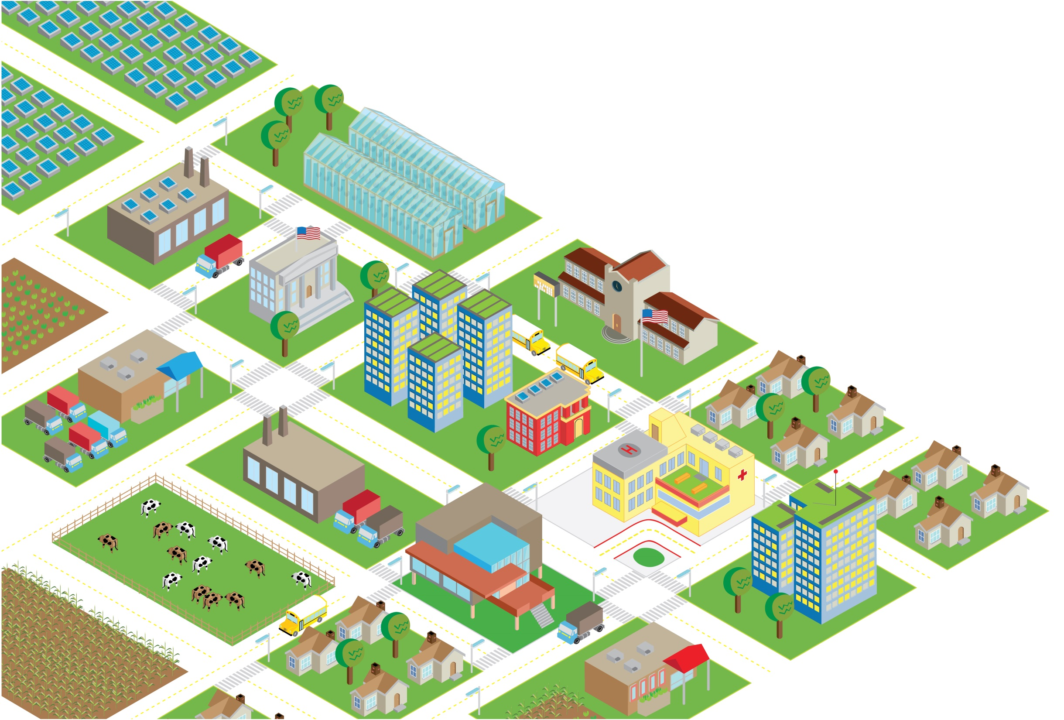
Community Wealth Building:
Designing a Nieuw-West Economy
For the 21st Century
Amsterdam
November 2023
Notes:
Introduction

Slide 2
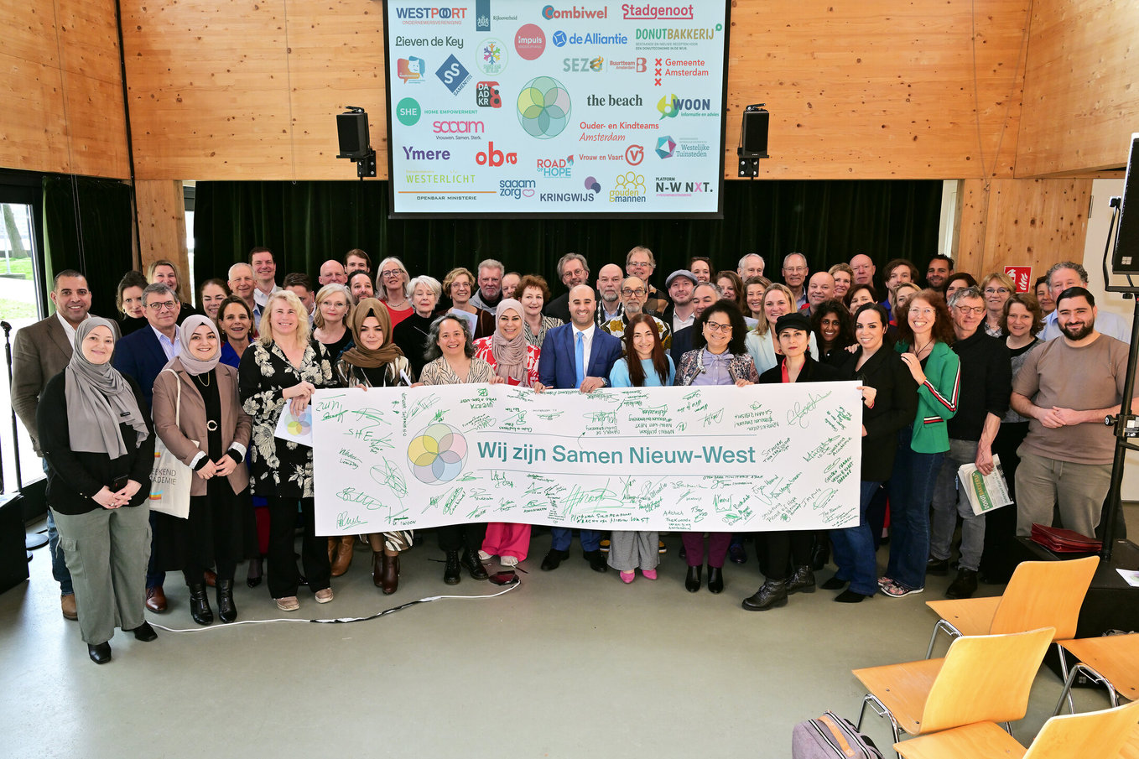
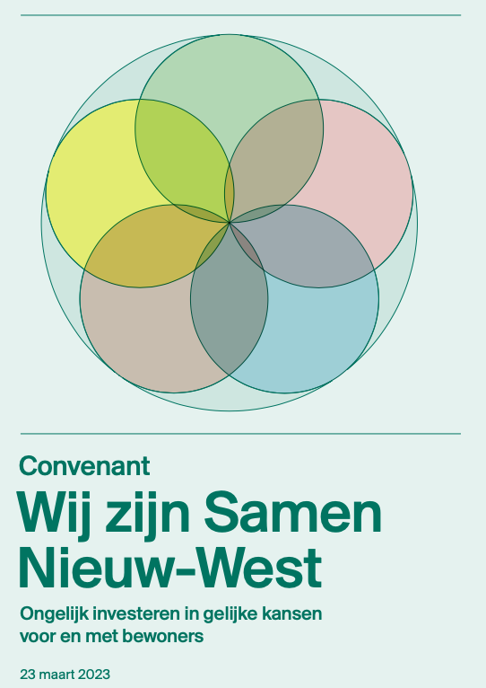
Community Wealth Building
In Amsterdam Nieuw-West
Notes:
CWB, NP SNW (foto convenant)

Slide 3
CWB Definition:
Community Wealth Building (CWB) is an economic development model that transforms local economies based on direct community ownership, control of assets in place, and ensuring that local financial resources recirculate and multiply.
Long Term Goals:
Shared economic prosperity, equity and inclusion, and
ecological sustainability

Slide 4
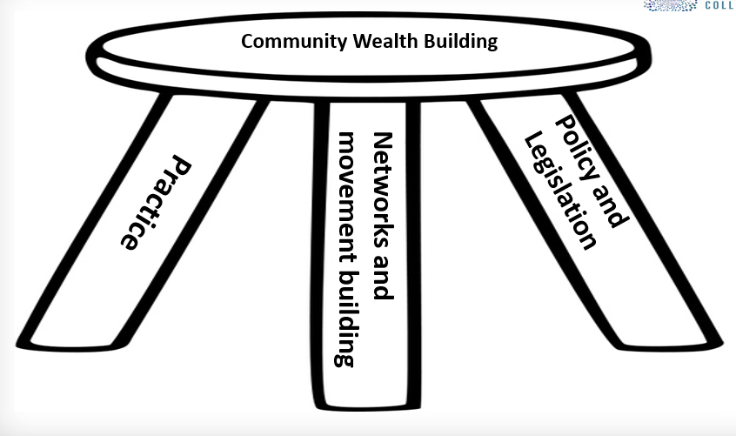
A Three-Legged Stool
Notes:
Not starting from a blank sheet – we have a number of progressive policies in Scotland that support the pillars and CWB.
We have taken a 3 legged stool approach to the development of CWB
Policy and legislation as you will all realise CWB touches on a vast array of policy and legislative areas.
Networks and movement building – we have been engaging with key stakeholders and organisations to raise awareness of CWB and share emerging good practice
Practice – at SG we took the decision to demonstrate how CWB can be used in localities to support economic development that works for places, people and businesses.
4

Slide 5
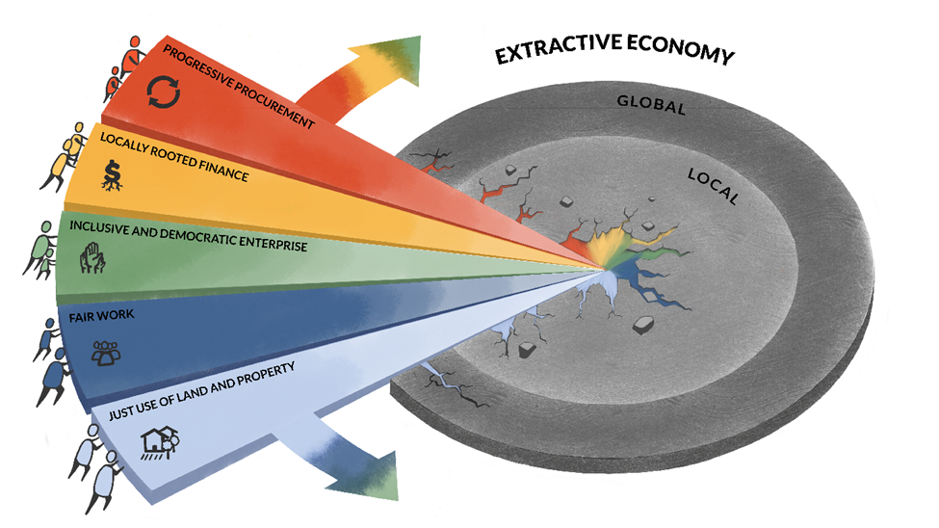
Community Wealth Building ‘Wedge’
Democratic Economy
Notes:
When these five pillars come together, they form the Community Wealth Building “Wedge.” The Wedge represents CWB’s truly transformative power – pulling together the actions within these pillars in an intentional and interconnected way, disrupting and displacing the extractive economy, and creating a new model that drives a more democratic economy from the local to the global.
Significant progress has made on action plans in several localities and regions over the past year.
Building a network of cities Includes Somerville.

Slide 6
Progressive procurement. Local governments and place-based “anchor institutions” should lead with procurement practices that re-localize economic activity, build local multipliers and end leakage and financial extraction
Just use of land and property. Cities should mobilize land and property assets to build real wealth in communities, bring local land and real estate development back under community control, and combat speculation and displacement.
Fair work. Every worker must receive a living wage and real power in and control of their workplace for decent work and conditions, and advancing trade union rights.

Slide 7
Inclusive and democratic enterprise. Cities should have multiple forms of worker and consumer cooperatives, social enterprises, municipal ownership/enterprise, and more, based on the recognition that the ownership of productive capital is at the heart of where power lies in any economic system.
Locally rooted finance. Cities and local institutions should redirect money in service of the real economy through public and community banks, credit unions, targeted public pension investments.

Slide 8
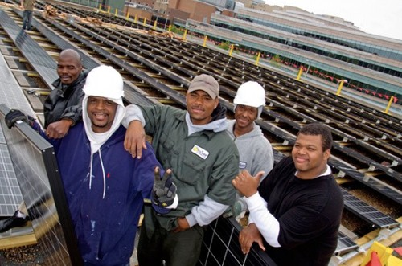
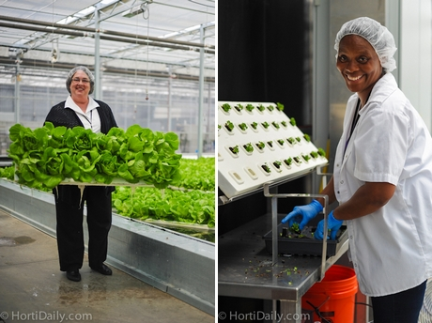
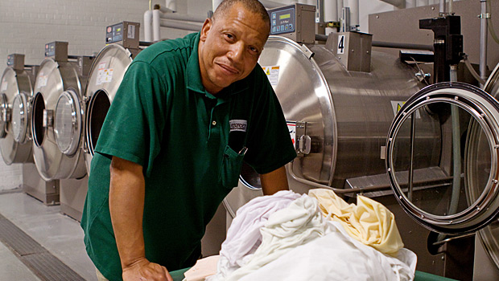
Evergreen Cooperatives Cleveland Ohio USA

Slide 9
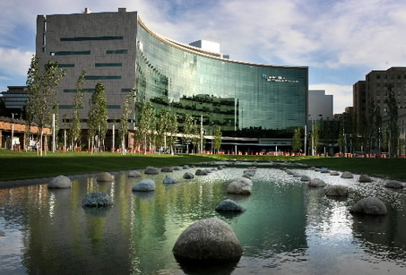
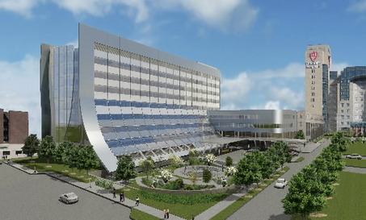
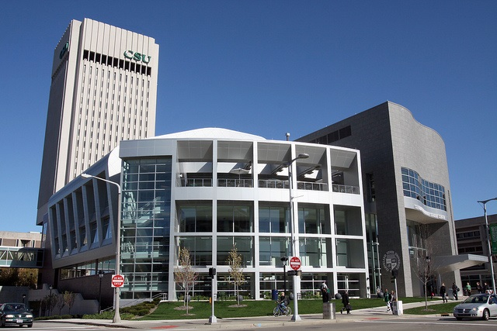
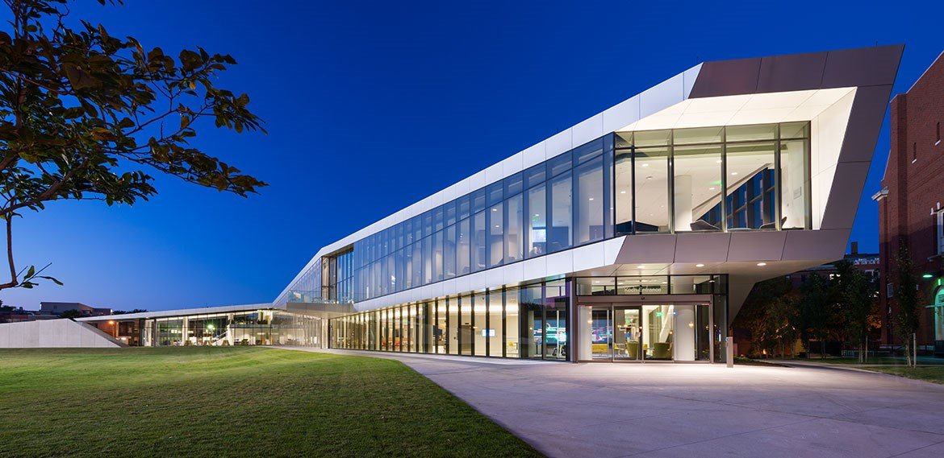
CLEVELAND ANCHOR INSTITUTION PROCUREMENT
$3 Billion+ Annually
Cleveland Clinic
University Hospitals
Cleveland State University
4. Case Western Reserve University
Notes:
9

Slide 10
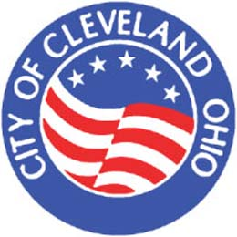
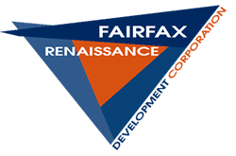

Slide 11
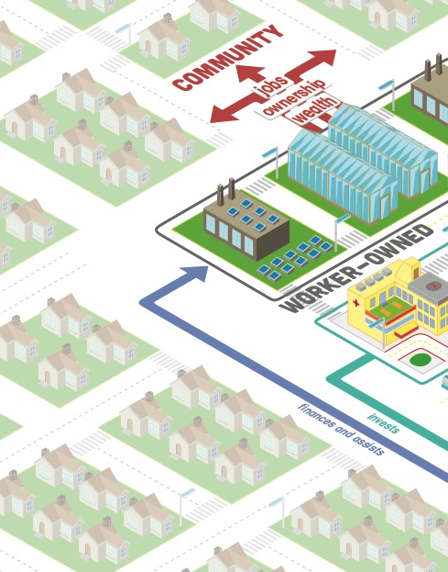
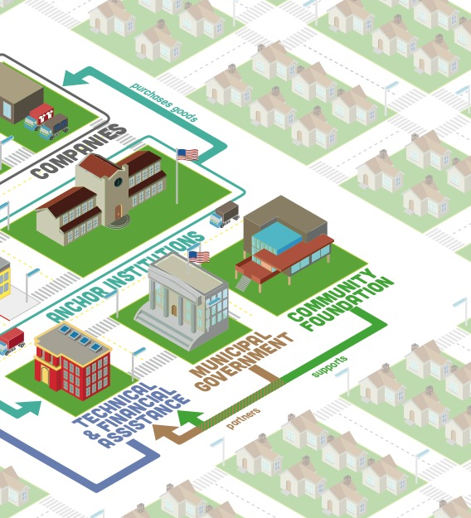
The Cleveland Model: Building an “Ecosystem”
Notes:
So what does it look like when all these pieces – place, ownership, and institutions – come together? In Cleveland, the Greater University Circle Initiative has brought together 6 anchor institutions including Case Western University and the Cleveland Clinic with the support of the Cleveland Foundation and city government to better connect their economic output to the struggling communities directly adjacent to their campuses. Working with local technical assistance providers and CDFIs, they helped incubate a network of three employee-owned cooperative that are located in and employ residents from these low-income communities.

Slide 12
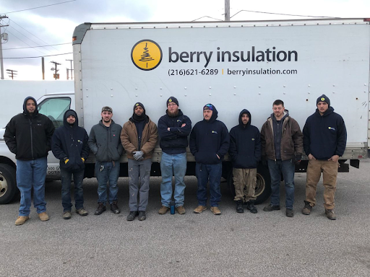
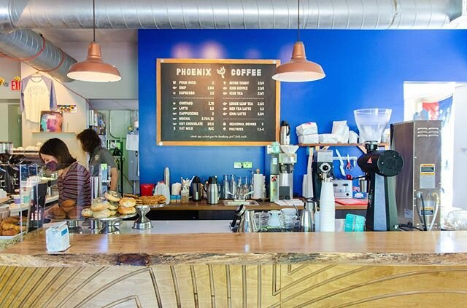

Slide 13
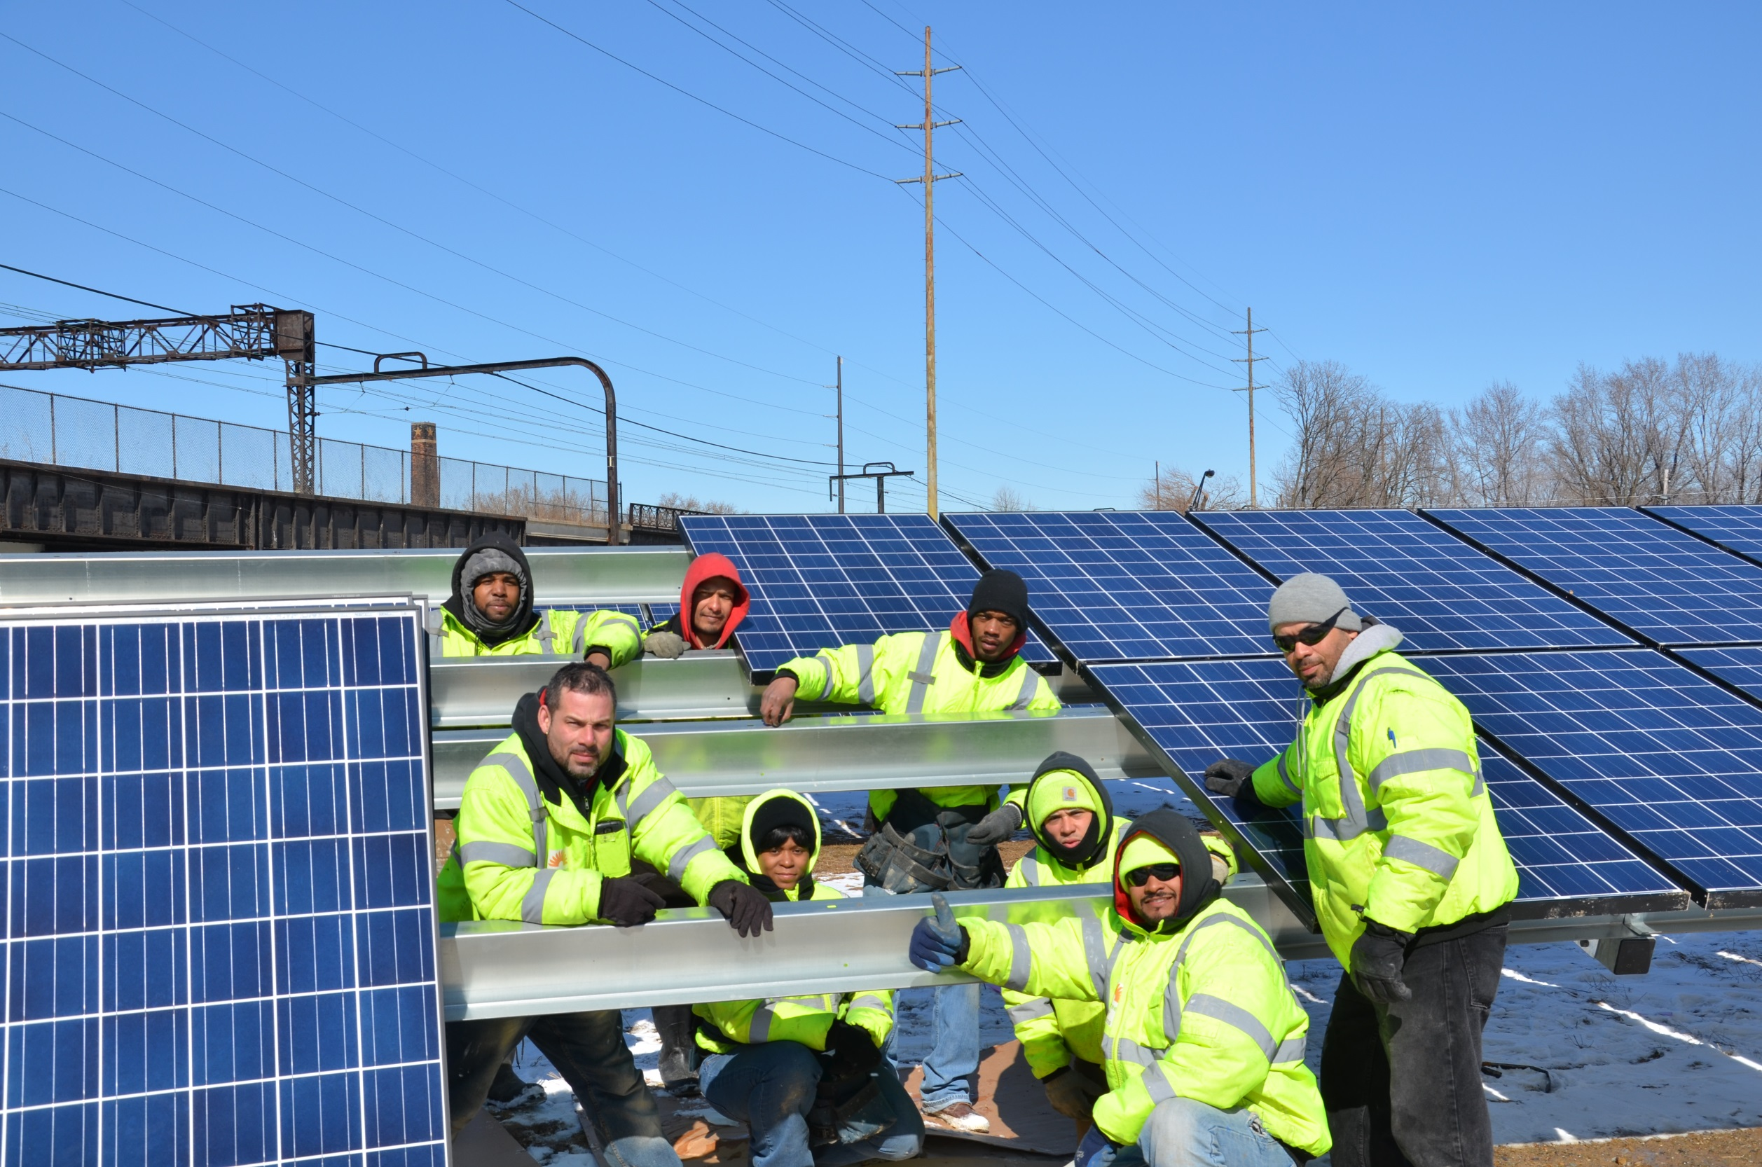
Evergreen Energy Solutions
Cleveland, OH

Slide 14
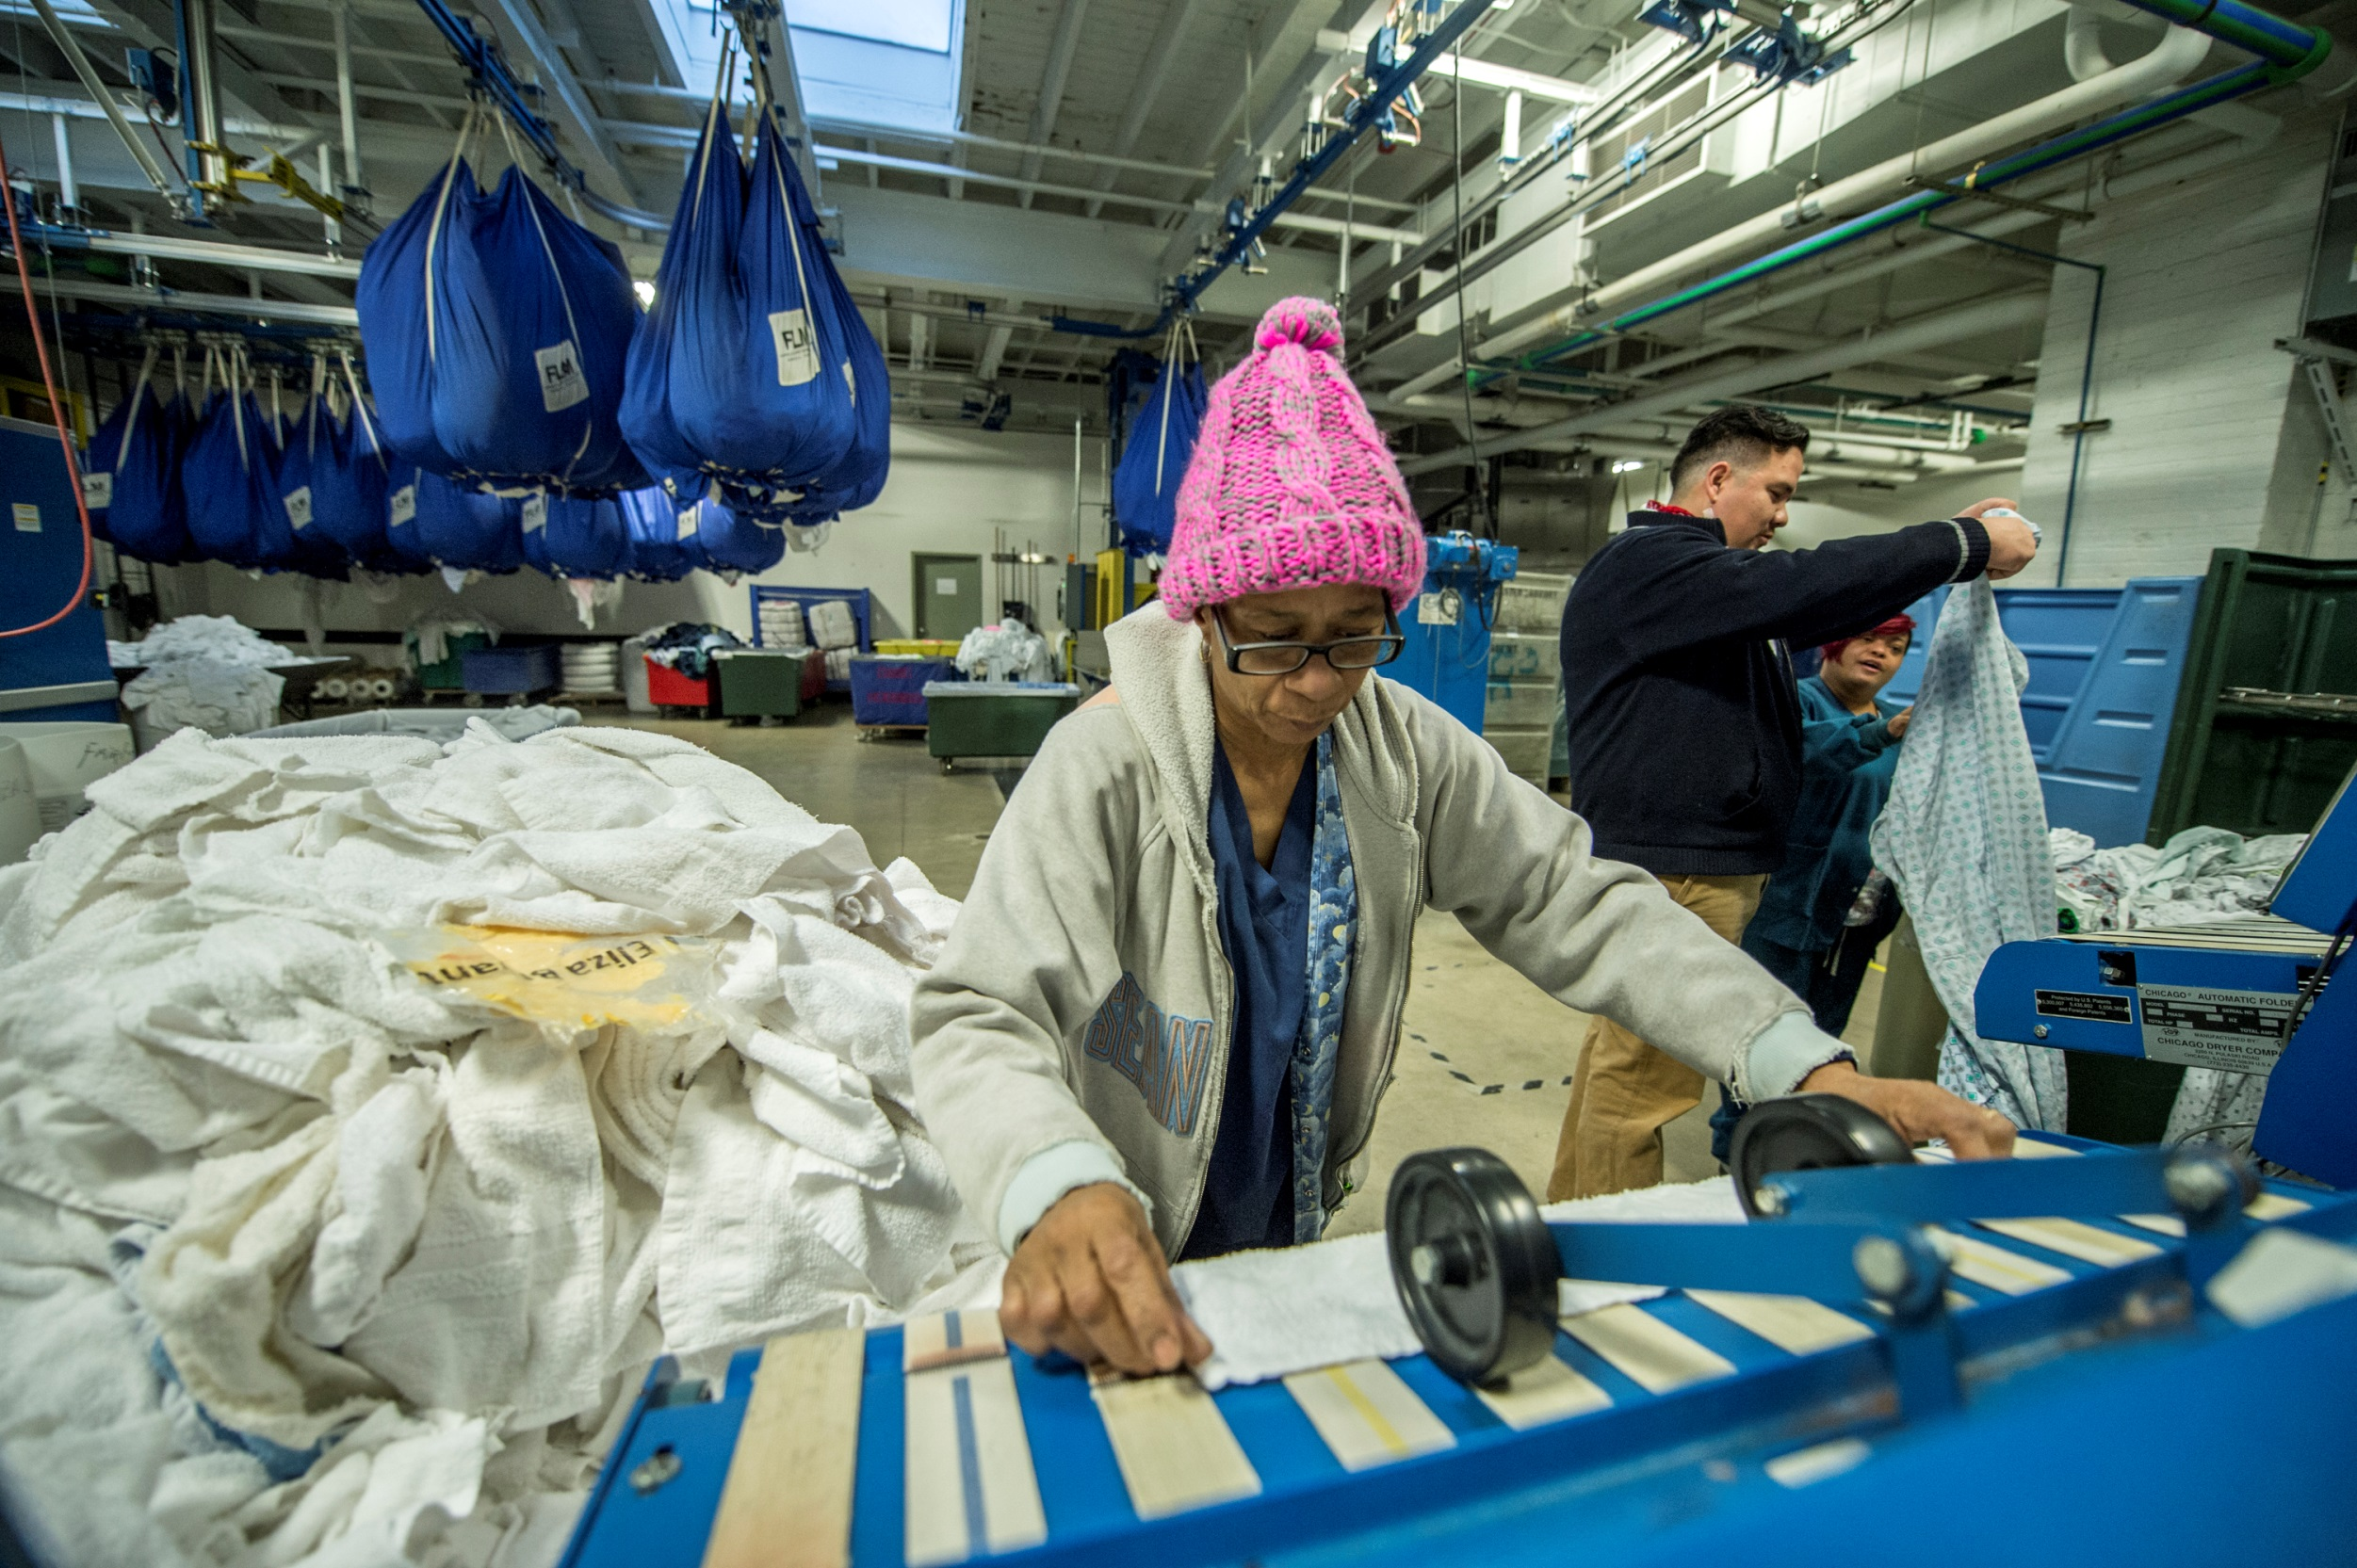
Evergreen Cooperative Laundry
Cleveland, OH

Slide 15
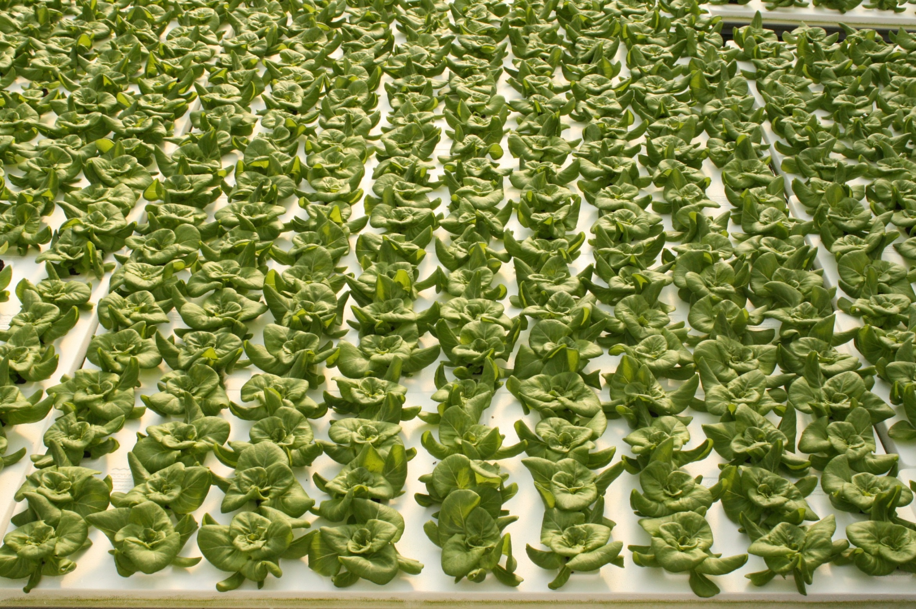
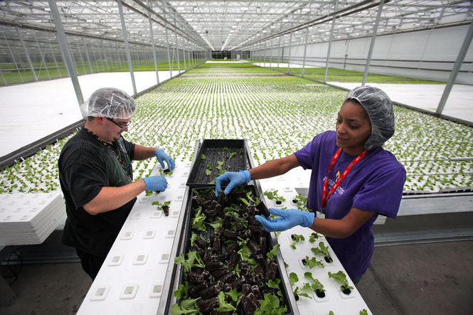
Green City Growers
Cleveland, OH

Slide 16
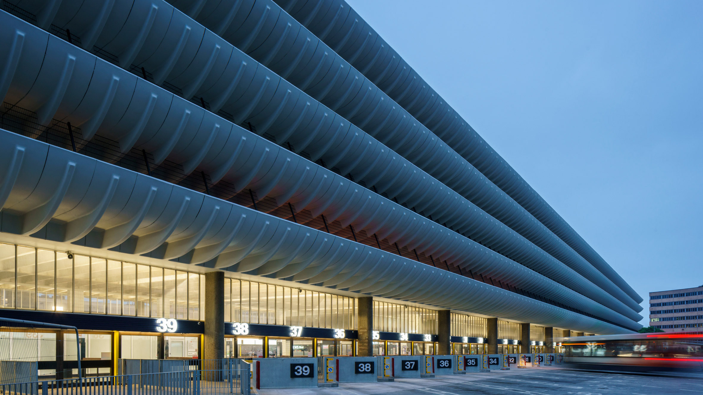
PRESTON
£70m more for city economy
£200m more for regional economy
Created 1600 more jobs
4000 more people - paid real living wage
Cooperative development network
Using local pension funds – local investment
North West Community bank

Slide 17
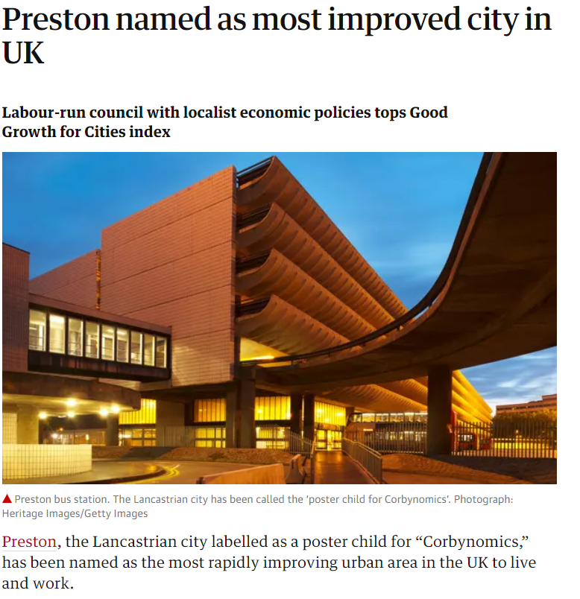

Slide 18
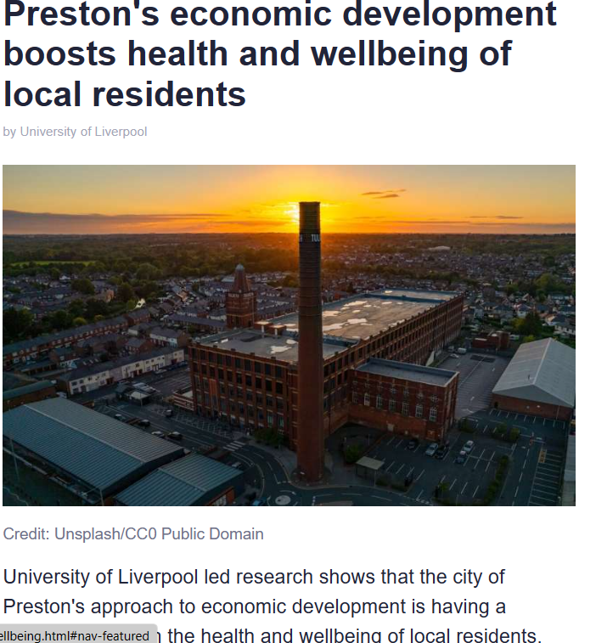

Slide 19
Institutions Matter
‘Community wealth builder In residence’
Workforce development (shortages in NHS Staff)
Linking tenants to Work opportunities in Anchors
Procurement directed to SME (up to 25k)
Notes:
Institutions such as universities, hospitals, and city governments are a big part of that solution. These institutions are rooted in place and their success goes hand-in-hand with the success of surrounding communities. These institutions often have a mission to serve and are often the largest employers and purchaser of goods and services in many communities. And unlike most large, multinational corporations, anchor institutions are not likely to pick up and leave these communities. These institutions offer “sticky” or local rooted capital that has the potential to create multiplier effects and benefits in these communities.

Slide 20
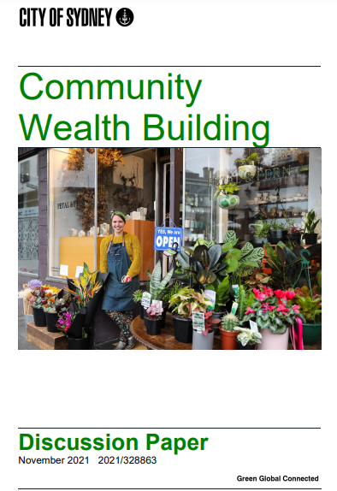
‘The application of these principles requires consideration of how the City can contribute to the building and retention of wealth in our area through targeted procurement, employment practices, use of City land and assets, and support for the diversification of the city economy.’
Notes:
So what does it look like when all these pieces – place, ownership, and institutions – come together? In Cleveland, the Greater University Circle Initiative has brought together 6 anchor institutions including Case Western University and the Cleveland Clinic with the support of the Cleveland Foundation and city government to better connect their economic output to the struggling communities directly adjacent to their campuses. Working with local technical assistance providers and CDFIs, they helped incubate a network of three employee-owned cooperative that are located in and employ residents from these low-income communities.

Slide 21
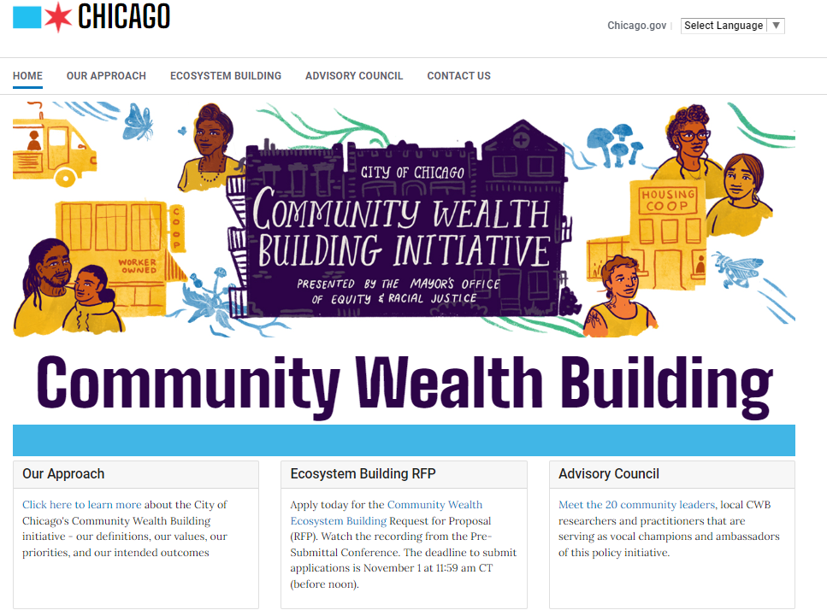

Slide 22
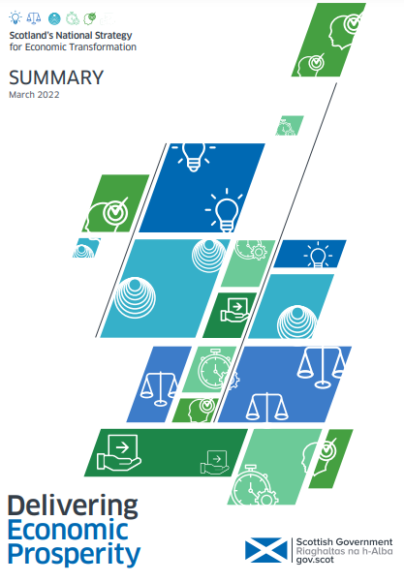
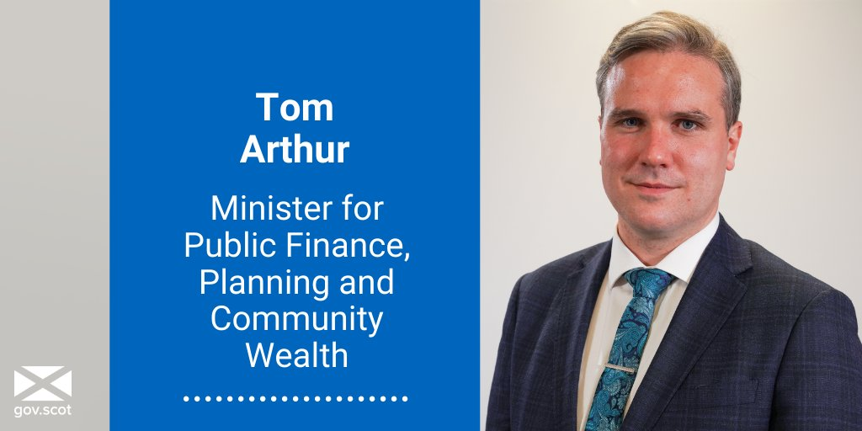

Slide 23
Perceiving and acting on the totality of public spending across all anchors as a vital economic lever
Returning more spend to local, regional and national economy
Using pre-commissioning process and imminent procurement demand as an opportunity to shape local markets and supply
Reducing carbon footprint of supply by using more local suppliers
Reducing costs, by developing supply chains and thus creating more entrants to market.
Spending

